Slide 1
5G Explained – Graphics, charts

Slide 2
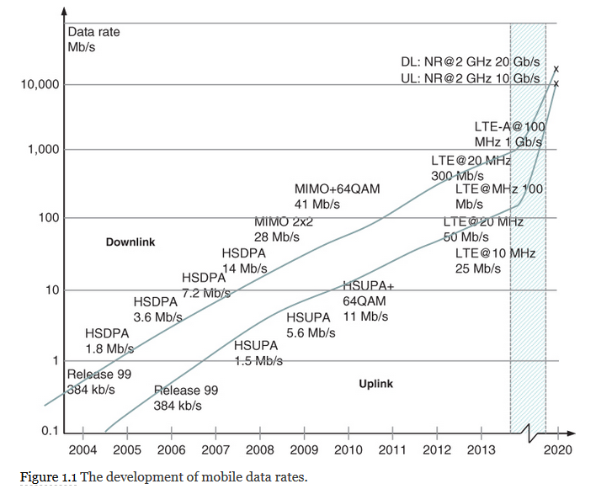

Slide 3
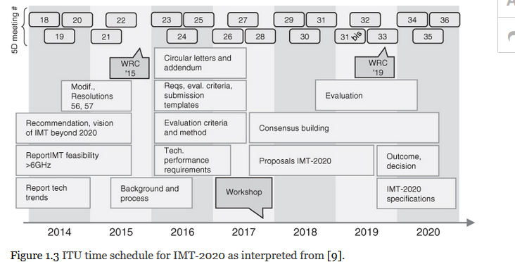
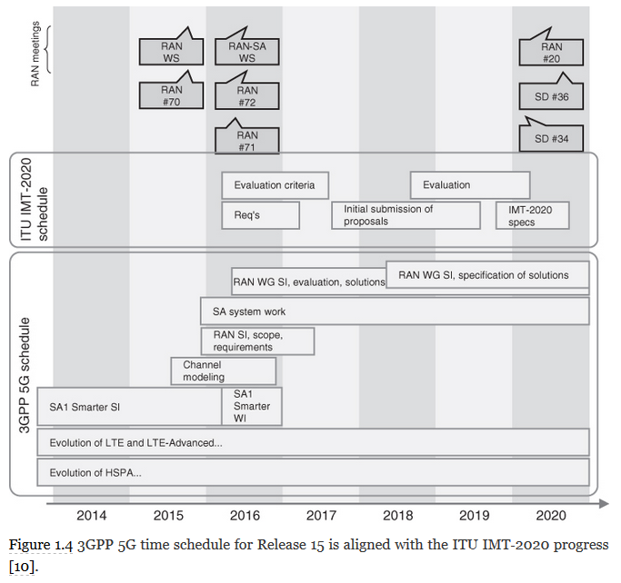

Slide 4
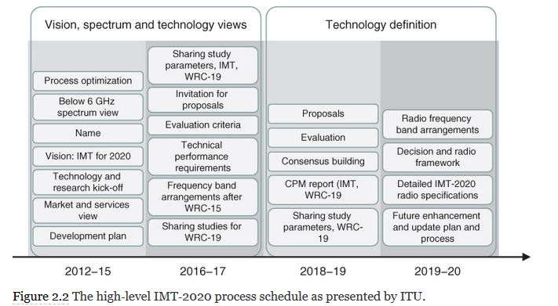

Slide 5
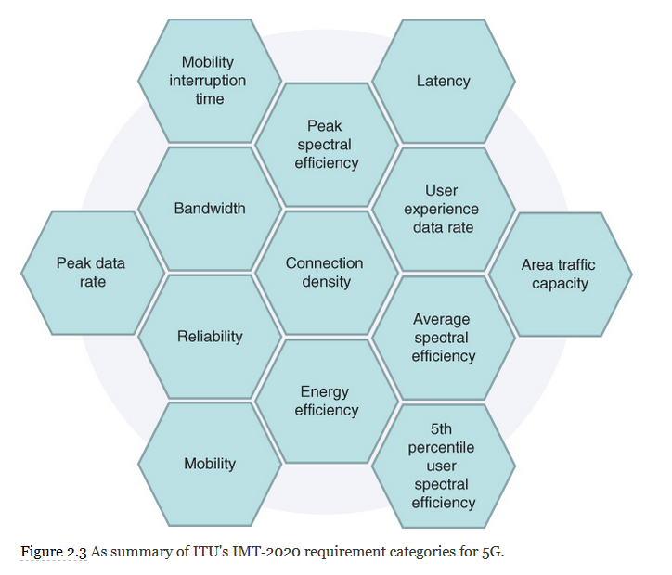

Slide 7
The 5G UE security requirements as interpreted from 3GPP/ETSI TS 33.501.
Requirement | Description of the requirement
Ciphering and integrity protection | Must be equal for the ciphering and integrity protection between the UE and the ng‐eNB, as well as between the UE and the eNB as dictated in 3GPP TS 33.401.
User data and signaling data confidentiality | UE must be able to activate used data ciphering as indicated by gNB. In addition, UE needs to support the following: User data, and RRC and NAS signaling ciphering in UE–gNB. NEA0, 128‐NEA1, and 128‐NEA2 ciphering algorithms, and optionally 128‐NEA3. Ciphering algorithms detailed in the 3GPP 33.401 if the UE can provide E‐UTRA connectivity to 5GC. UE should use confidentiality protection when regulations so permit, although the confidentiality protection of user data between the UE and the gNB, and confidentiality protection of RRC‐signaling and NAS‐signaling, are left optional.
User data and signaling data integrity | The UE supports the following: Integrity protection and replay protection of user data in UE–gNB. Integrity protection and replay protection of RRC and NAS‐signaling, and integrity protection of user data as dictated by the gNB. NIA0, 128‐NIA1, 128‐NIA2 integrity protection algorithms. The UE may implement optionally also the 128‐NIA3. Integrity algorithms as detailed in 3GPP TS 33.401 if the UE supports E‐UTRA connectivity to 5G core network. Nevertheless, the actual use of user data integrity protection in UE–gNB interface is left optional, as it adds overhead and processing load. Integrity protection of the RRC and NAS signaling with some exceptions indicated in 3GPP TS 24.501 and TS 38.331.
Secure storage and processing of subscription credentials | For the storage and processing of the subscription credentials to access the 5G network, the following applies: The subscription credentials are integrity‐protected within the UE using a tamper‐resistant secure hardware component. The long‐term K keys of the subscription credentials are confidentiality‐protected within the UE using a tamper‐resistant secure hardware component. The long‐term keys of the subscription credentials are never presented in the clear format outside of the tamper‐resistant secure hardware component. The authentication algorithms for the subscription credentials are executed within the tamper‐resistant secure hardware component. A security evaluation and assessment must be possible to assess the compliance of security requirements of the tamper‐resistant secure hardware component.
Subscriber privacy | As for the subscriber privacy, the following applies: The UE supports 5G‐GUTI. The SUPI is not transferred in clear text format via 5G RAN. The exception of this rule is the routing information (Mobile Country Code, MCC and Mobile Network Code, MNC), which can be exposed. Please note that SUPI privacy protection is not required for unauthenticated emergency call. USIM houses the home network public key. ME supports the null‐scheme. This applies in the scenario when the home network has not provisioned the public key within USIM, and there is thus no SUPI protection in initial registration procedure, and the ME uses null‐scheme. Either USIM or ME can calculate the SUCI upon MNO rules, which USIM indicates. Home network operator controls the provisioning and updating of the home network public key within the tamper‐resistant hardware, as well as the subscriber privacy enablement.
 | For the user and signaling data integrity, the following applies: The UE supports integrity protection and replays protection of user data and RRC/NAS signaling in UE–gNB interface. gNB indicates the use and UE activates accordingly integrity protection of user data. Support of NIA0, 128‐NIA1, and 128‐NIA2 integrity protection algorithms, and optionally 128‐NIA3. Nevertheless, the actual use of integrity protection of the user data in UE–gNB is optional. The UE houses the integrity algorithms as defined in 3GPP TS 33.401, if the UE supports E‐UTRA connectivity to 5GC. Integrity protection of the RRC and NAS‐signaling is mandatory to use, except in cases summarized in 3GPP TS 24.501 and TS 38.331.

Slide 8

The 5G gNB security requirements as interpreted from 3GPP/ETSI TS 33.501
Requirement | Description of the requirement
User data and signaling data confidentiality | For the user data and signaling data confidentiality, the following applies: The gNB supports ciphering of user data and RRC‐signaling in UE–gNB. Session management function (SMF) dictates the use, and the gNB activates ciphering of user data. The gNB supports NEA0, 128‐NEA1, and 128‐NEA2 ciphering algorithms, and optionally, the 128‐NEA3. It is optional to support confidentiality protection of user data and RRC‐signaling in UE–gNB. It should be noted that confidentiality protection is encouraged to be applied when regulations so permit.
User data and signaling data integrity | For the user and signaling data integrity, the following applies: The gNB supports integrity protection and replays protection of user data and RRC signaling in UE–gNB. SMF dictates and gNB activates integrity protection of user data. The gNB supports NIA0, 128‐NIA1, and 128‐NIA2 integrity protection algorithms, and optionally 128‐NIA3. Nevertheless, the actual use of integrity protection of the user data in UE–gNB is left as optional. RRC signaling messages excluding the cases detailed in the 3GPP TS 38.331 are integrity‐protected. The enablement of NIA0 in gNB depends on the regulatory requirements for the support of unauthenticated emergency session.
gNB setup and configuration | For the gNB setup and configuration, the following applies: When O&M sets up and configures gNBs, if MNO so dictates, the gNB authenticates and authorizes the procedure according to the certification scenario detailed in 3GPP TS 33.310. This is to prevent external parties to modify gNB settings and configuration by using local or remote access. The communication in O&M–gNB is confidentiality, integrity and replay protected. The security associations between O&M, gNB, and the 5G core network are detailed in the 3GPP TS 33.210 and TS 33.310. The gNB can authorize the intentions for (authorized) software and data changes. Secure environment is applied for execution of sensitive parts of the boot‐up. Confidentiality and integrity of software, which is transferred to gNB, needs to be ensured, and the software update of gNB must be verified upon installation as dictated in 3GPP TS 33.117.
gNB key management | For the key management in the gNB, the following applies: The key protection is of utmost importance when 5G core network provides the keying material for the gNBs. The parts of gNB deployment storing or processing keys in clear format must be protected from physical attacks, possibly applying secure physical environment. Keys in such secure environment must be stored only there, excluding cases allowed by 3GPP specifications.
Handling of user and control data for the gNB | For handling gNB user and control plane data, the following applies: Parts of gNB storing or processing user or control plane data in clear format must be protected against physical attacks. Otherwise, the entity needs to be placed in a physically secure location for storing and processing the user and control plane data in clear format.
Secure environment of the gNB | The secure environment protects sensitive information and operations from unauthorized access or exposure. For the secure environment logically defined within gNB, the following applies: It supports secure storage for sensitive data and execution of sensitive functions such as encryption and decryption of user data. It also supports the execution of sensitive parts of the boot‐process. The integrity of the secure environment must be assured. The access to the secure environment must be authorized.
gNB F1 interfaces | The set of NBs with split DU‐CU (distributed unit, centralized unit) implementations based on F1 interface is defined in 3GPP TS 38.470. For the gNB F1 interface, the following applies: Signaling traffic F1‐C as defined in 3GPP TS 38.470, F1‐C signaling bearer as defined in TS 38.472, and user plane data can use F1 interface in DU–CU. gNB supports confidentiality, integrity, and replay protection for F1‐C signaling bearer, and the management traffic on F1‐C interface (as per 3GPP TS 38.470) must be integrity, confidentiality, and replay protected. The gNB supports confidentiality, integrity, and replay protection on the gNB DU–CU F1‐U interface for user plane.
gNB E1 interfaces | The 3GPP TR 38.806 describes the E1 interface. For the gNB E1 interface, the following applies: The 3GPP TS 38.460 defines the principles for the gNBs with split DU–CU implementation, including open interface between CU–CP and CU–UP using the E1 interface. The E1 interface between CU–CP and CU–UP is confidentiality, integrity, and replay protected.

Slide 9
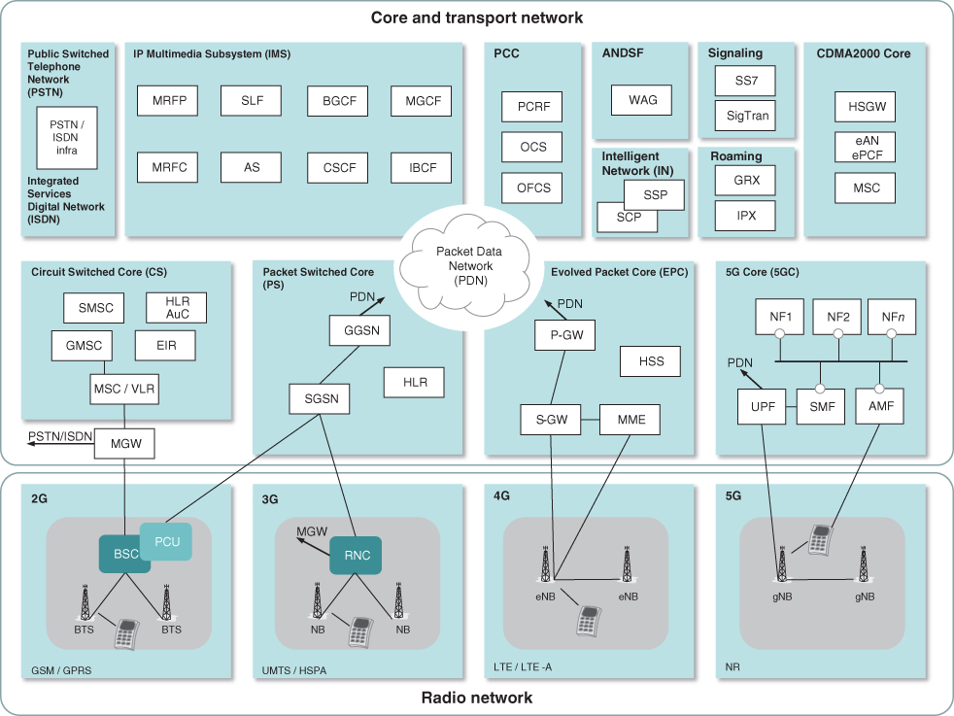

Slide 11
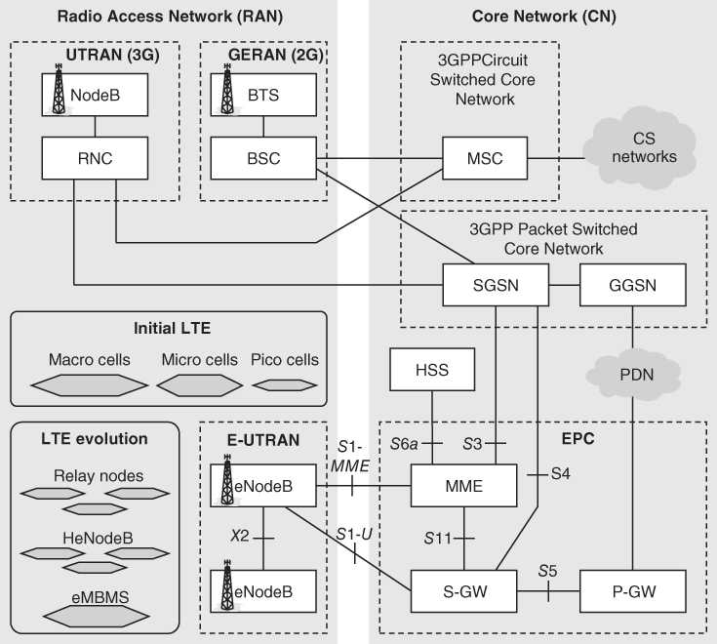
Figure 4.2 The key elements of 2G, 3G, and 4G network architecture prior to 5G deployment.

Slide 12
Figure 4.2 The key elements of 2G, 3G, and 4G network architecture prior to 5G deployment.

Slide 13
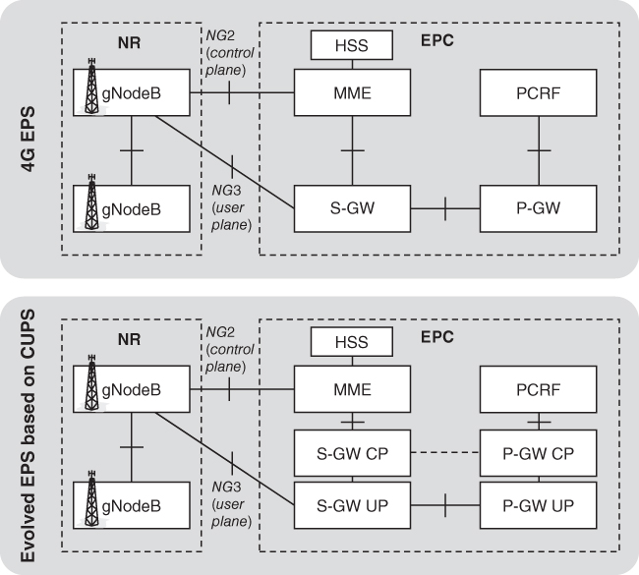

Slide 15
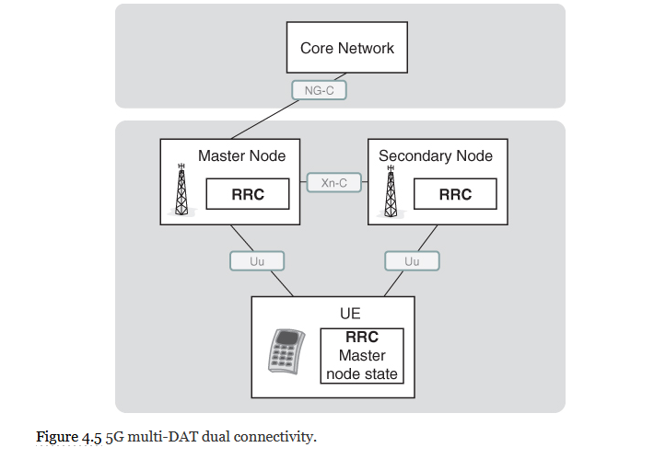

Slide 17
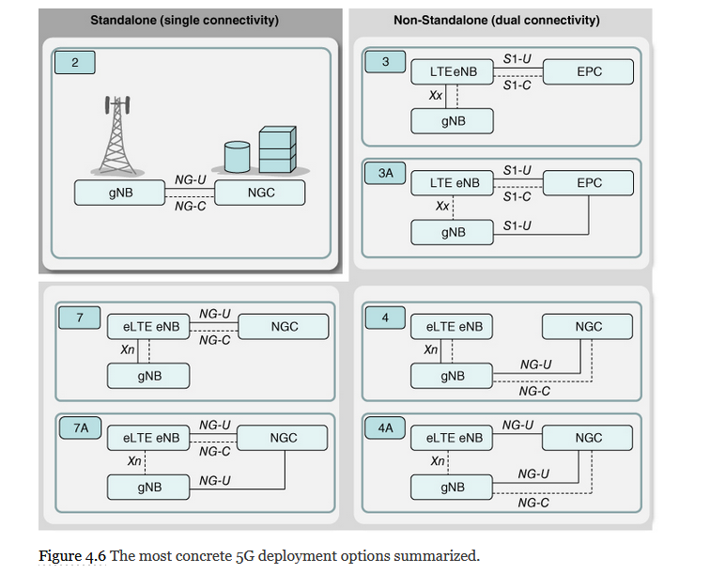

Slide 19
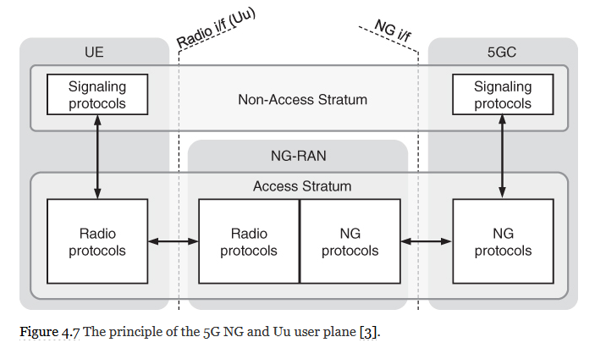

Slide 21
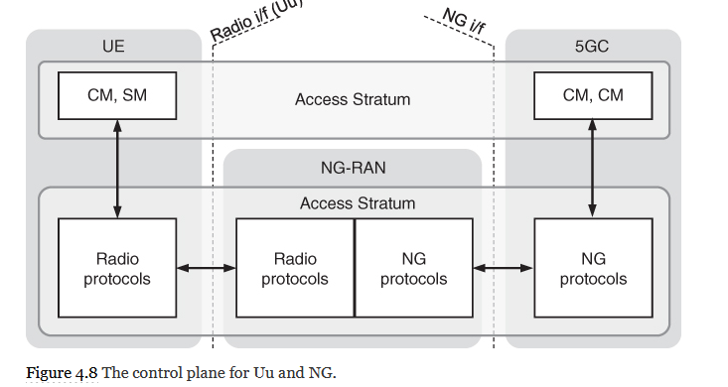

Slide 22
(Non)

Slide 23
(Non)

Slide 24
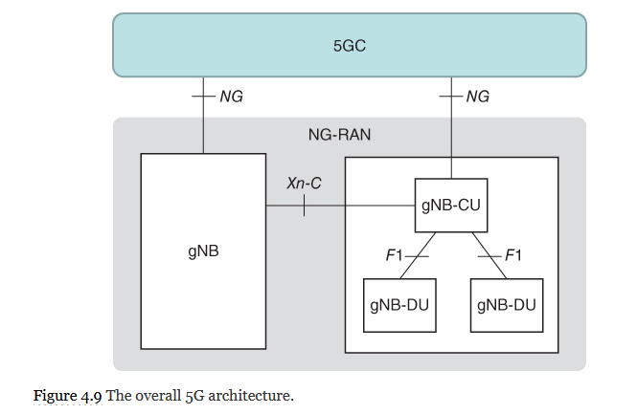

Slide 26
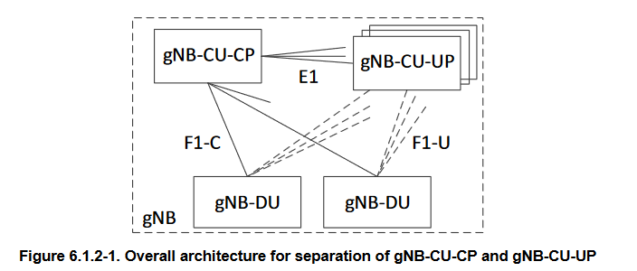

Slide 28
